Slide 1
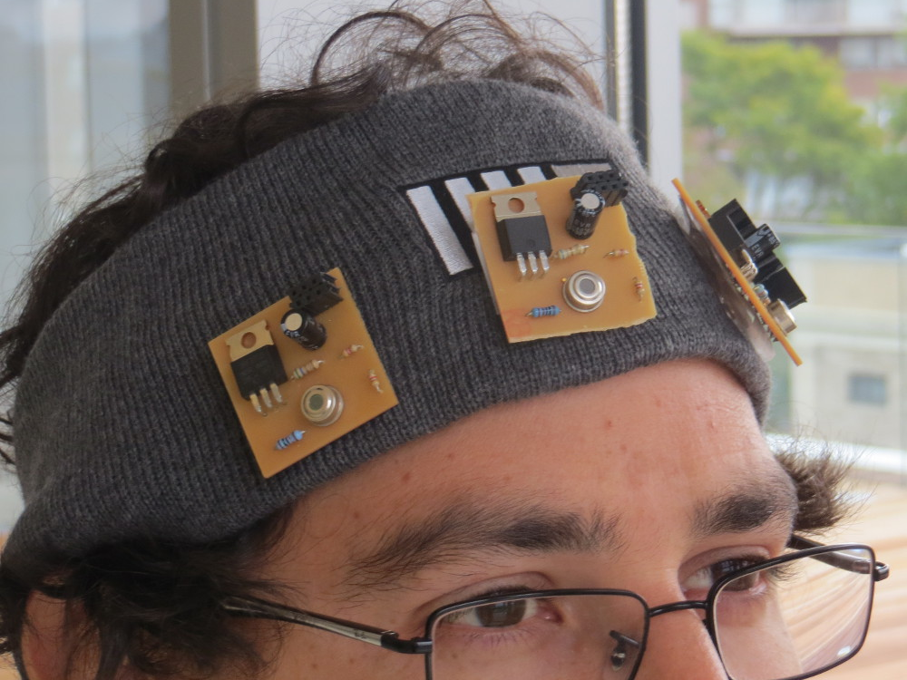
Digital Synesthesia
Using Mobile Technology to Interact with Our World
Committee:
V. Michael Bove Jr.
Joseph Paradiso
Kevin Slavin
PhD Proposal By:
Santiago Alfaro

Slide 2
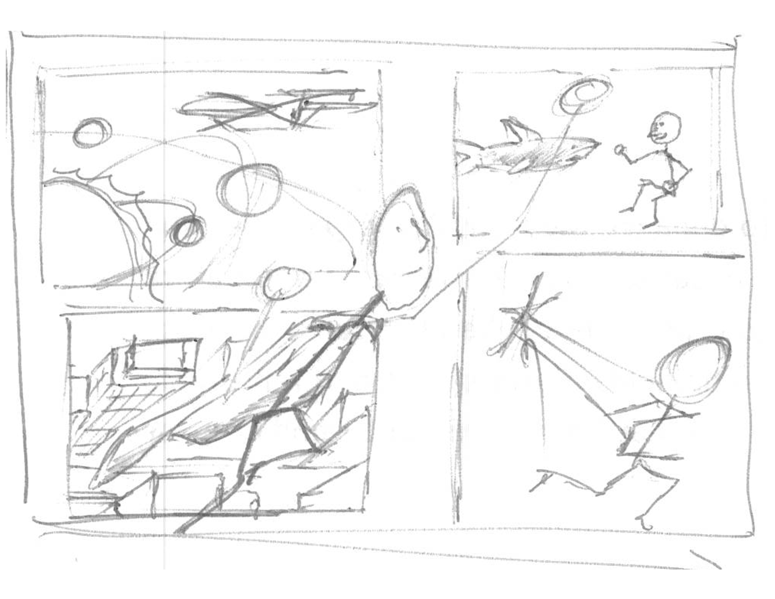
Humans have dreamt of going past our physical capabilities like…
… Breathing under water…
… Speed…
… going to space…
… or flying.
Notes:
Intro: Dreams:
Dreams - breathing under water – speed – space – flying.

Slide 3
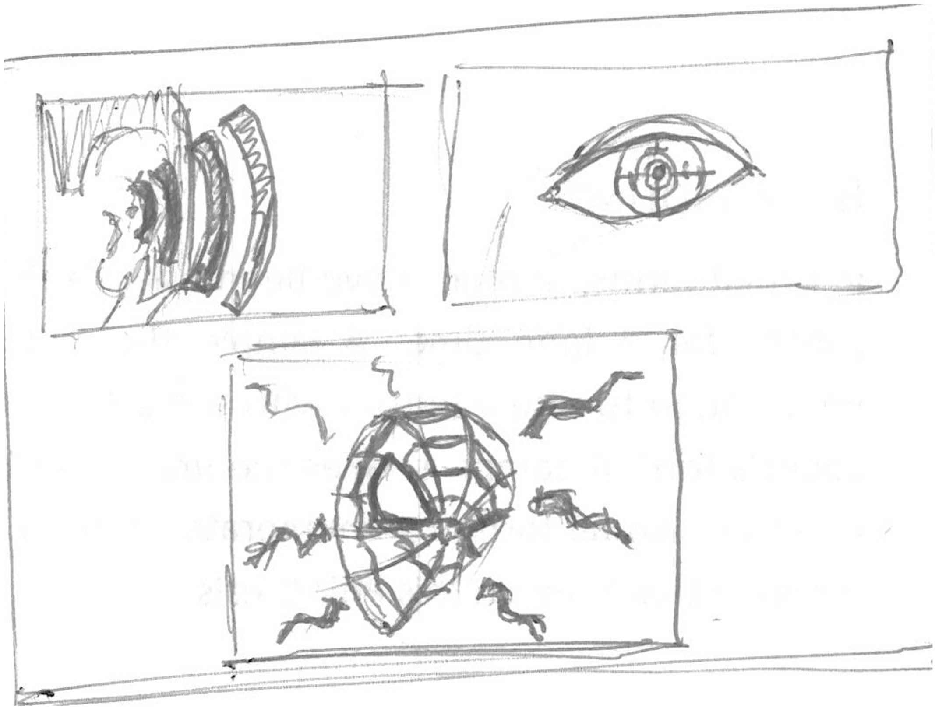
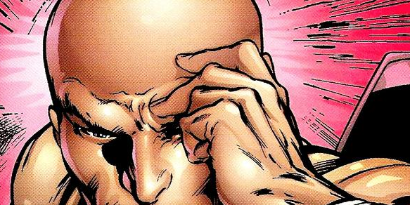
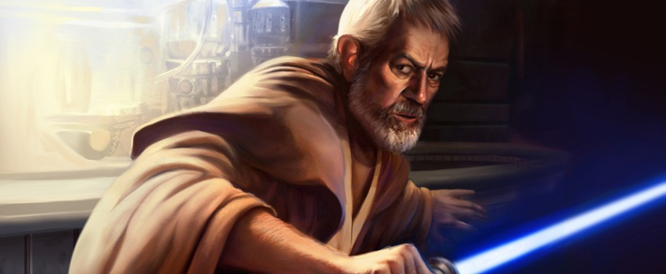
Other dreams are about our senses…
Some are about senses we don’t possess
… sight…
… spidey sense…
… hearing…
… a disturbance in the force.
Notes:
Intro: Super Heroes
Senses – Sight – sound – porf X – Spidey - Quickening

Slide 4
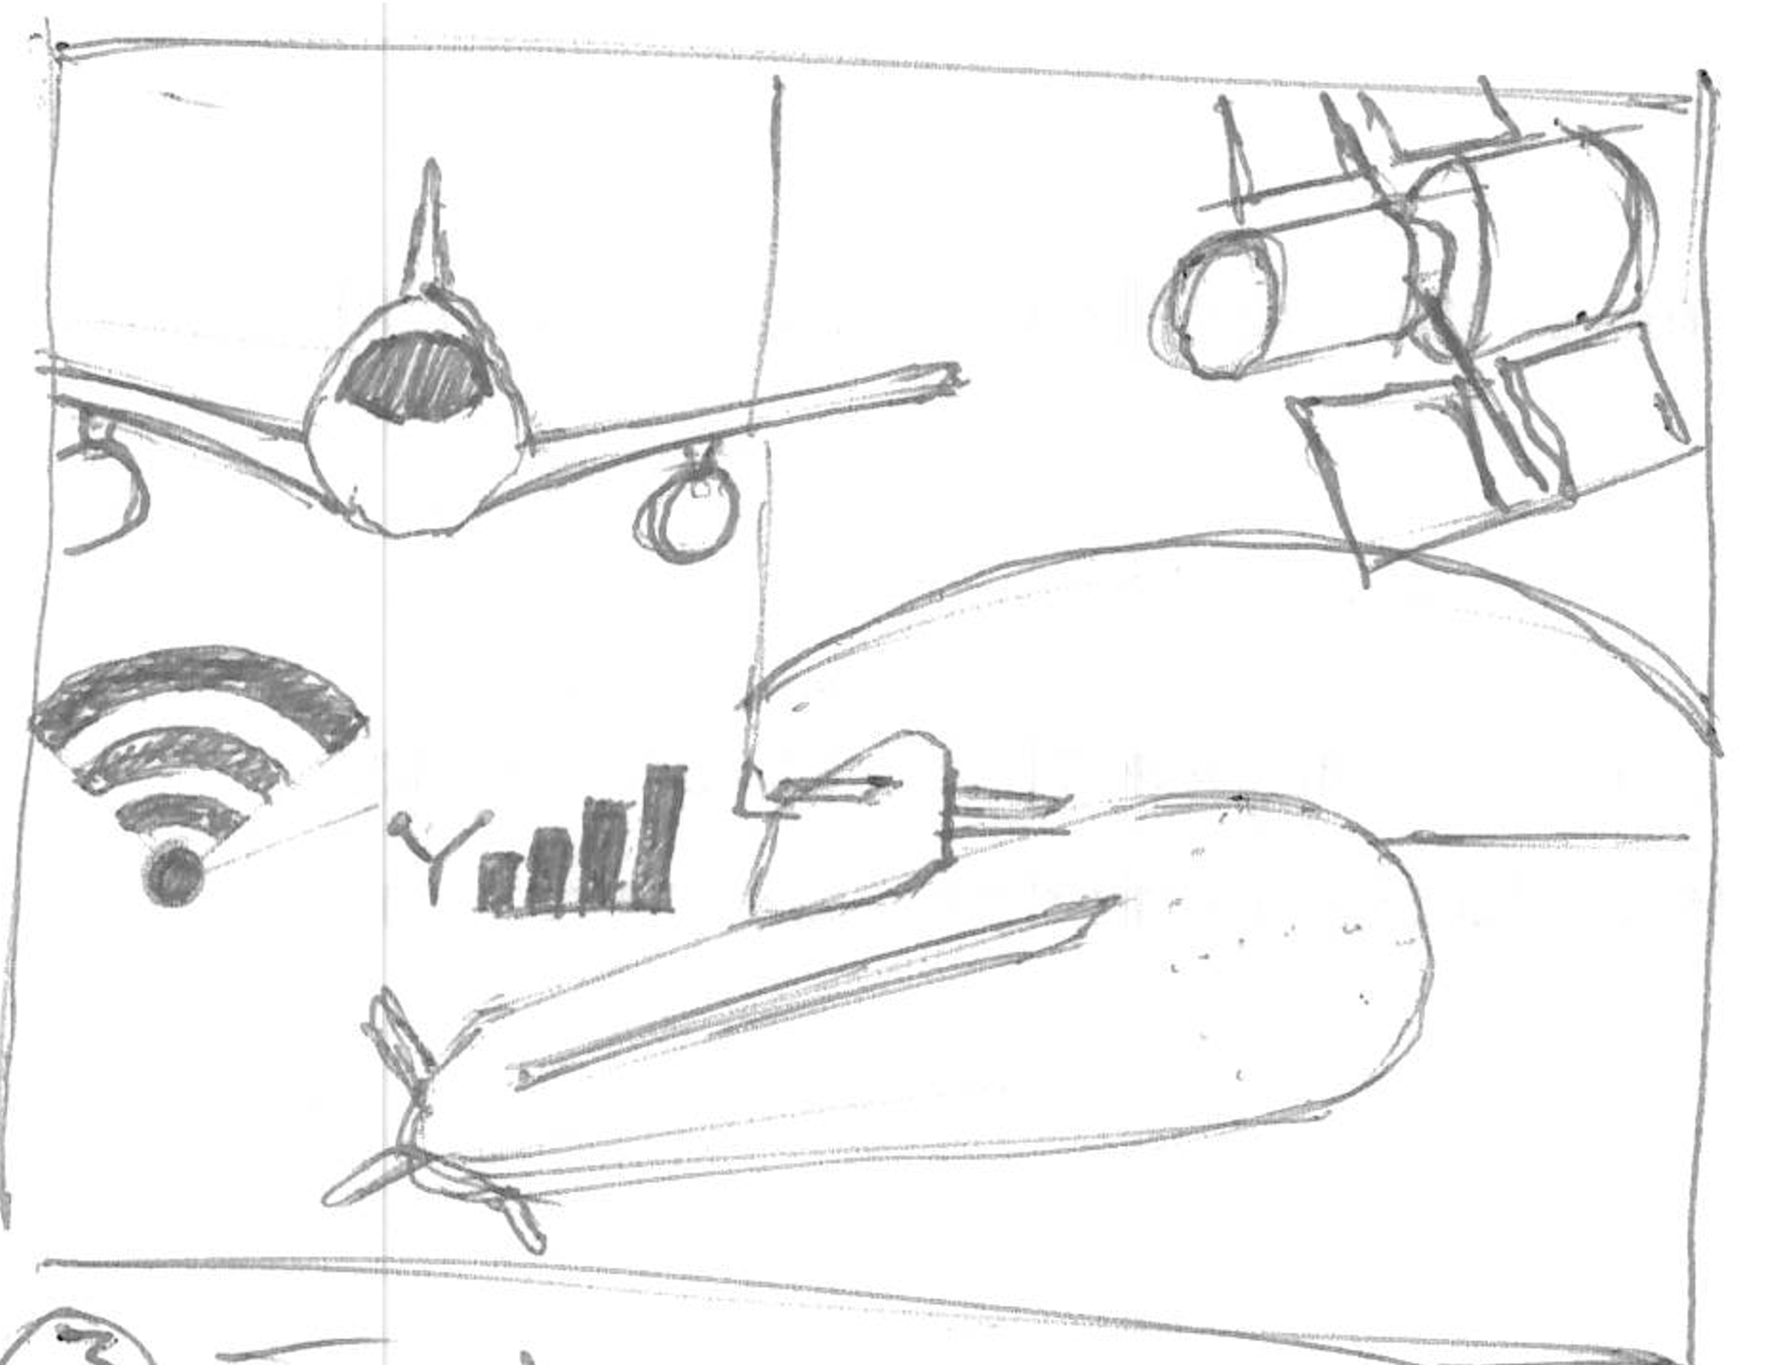
WE have reached some dreams
AND UNDERSTANDING OUR WORLD
With technology
Notes:
Intro: Technology

Slide 5
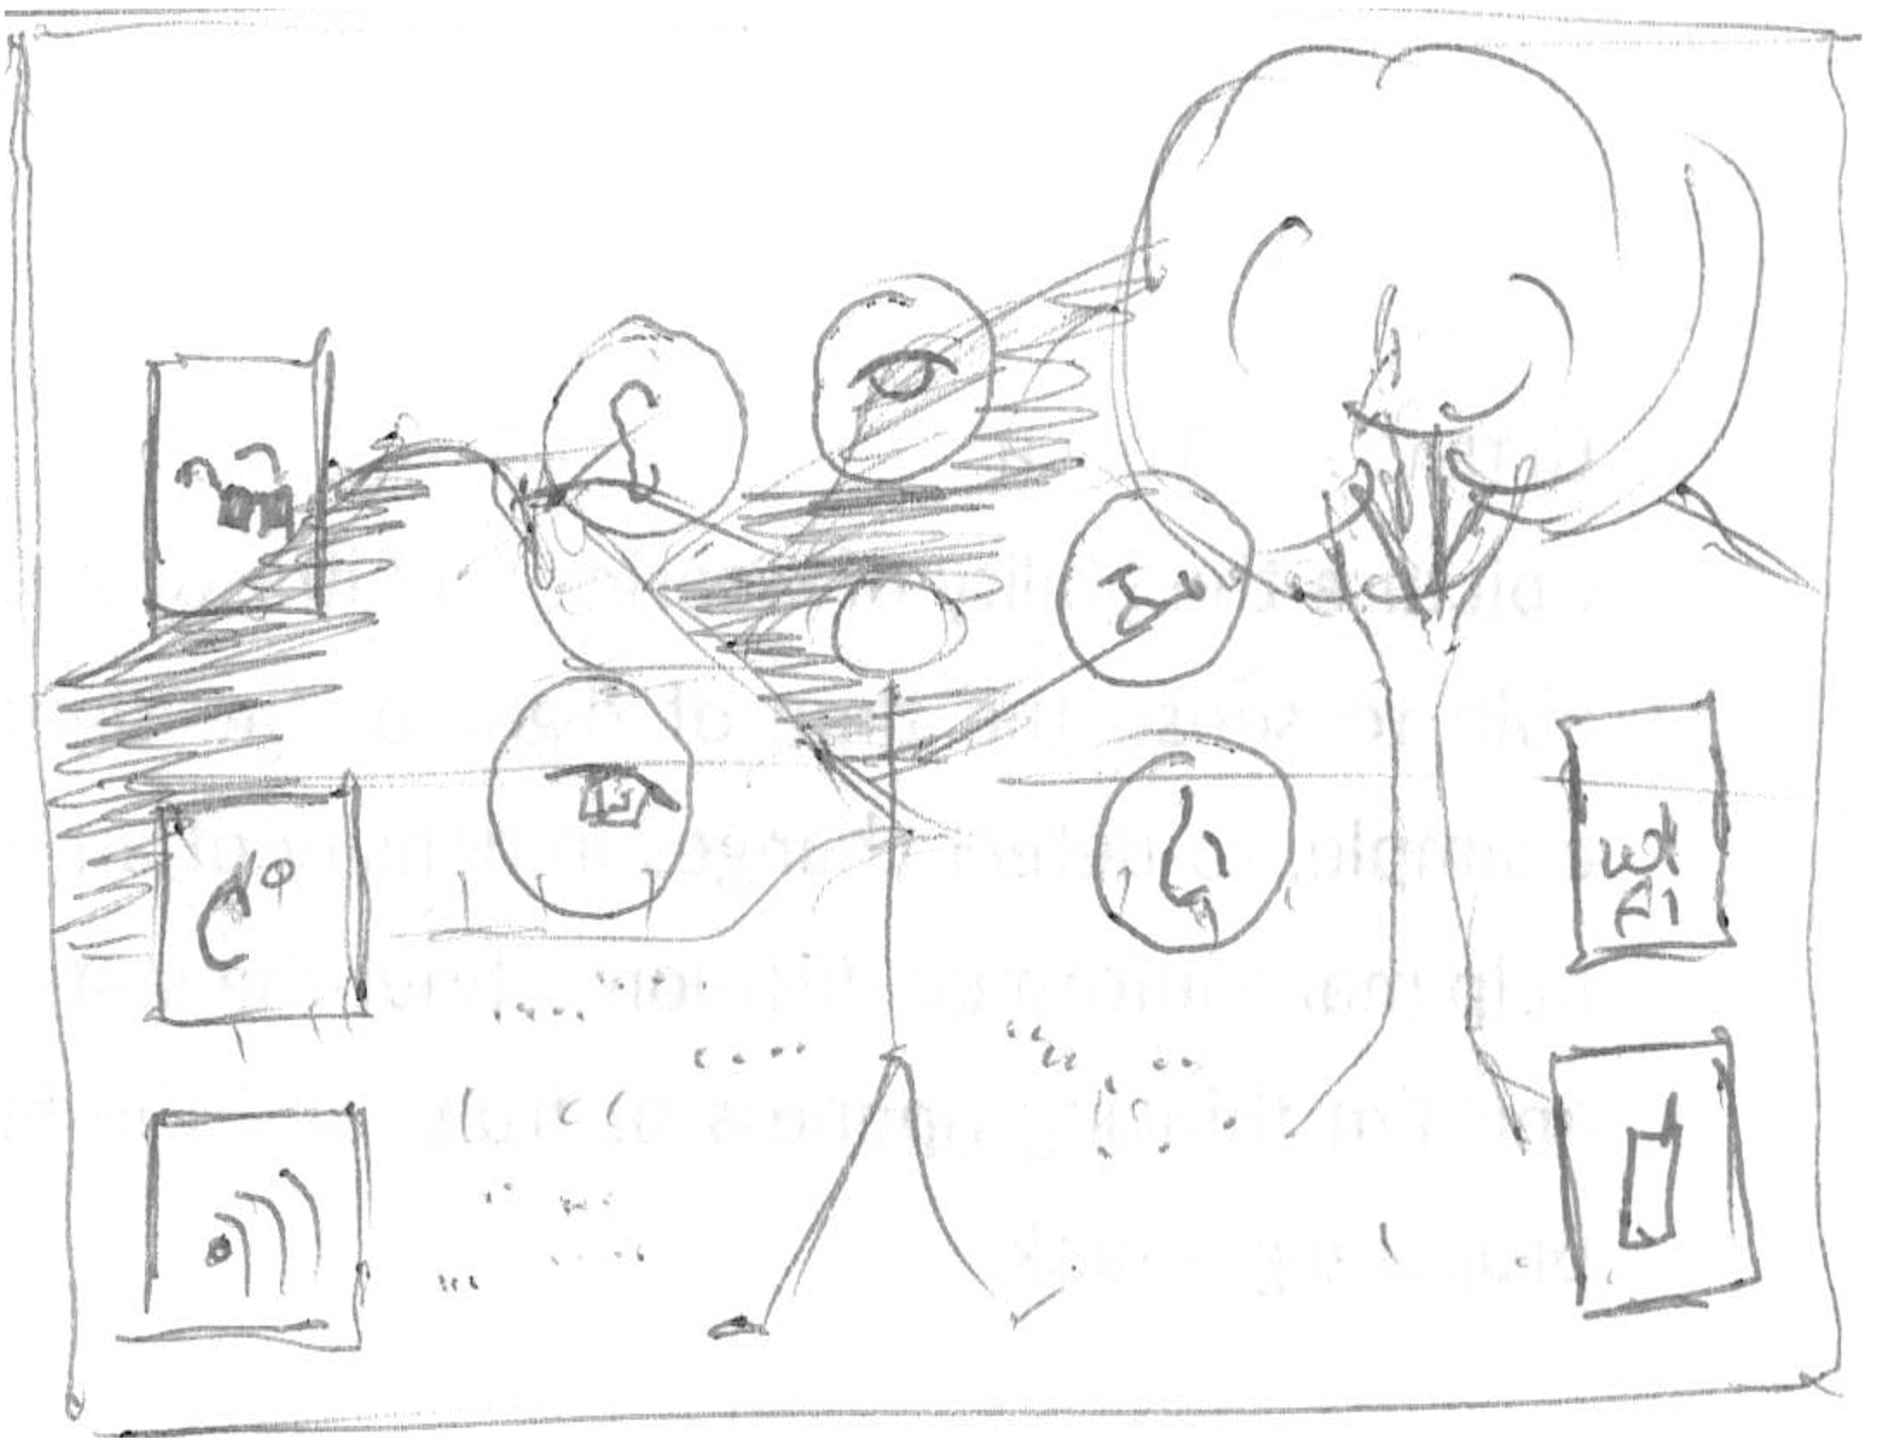
Intro - what
WE have reached some dreams
WE have reached some dreams
More info than can be sensed, in the world
WE have reached some dreams
WE have reached some dreams
WE have reached some dreams
WE have reached some dreams
Notes:
Intro: More than we can sense
Our 5 senses – IR – UV – Magnetic Waves – WiFi – Cellphone

Slide 6
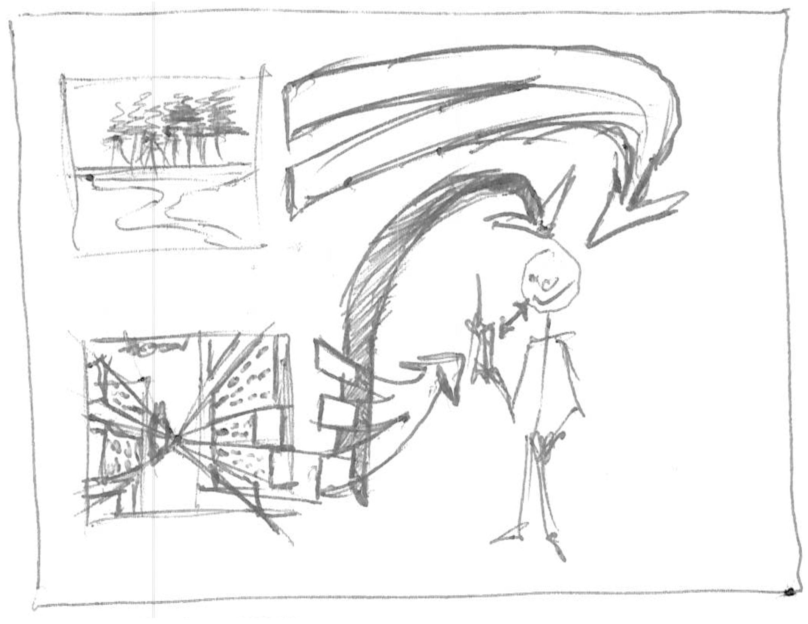
Intro - what
WE have reached some dreams
WE have reached some dreams
Mobile device a translator
WE have reached some dreams
Notes:
Intro: Mobile Device as translator
Some go to the user – Some go to the phone and then to the user.

Slide 7
Intro - why
Physical connection to the world by-pass device and cognition.

Slide 8
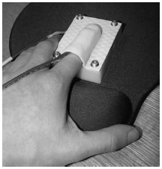
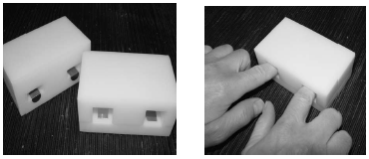
Different material are placed in the device
The pressure and temperature change of the finger was measured
The subject must identify the warmer and colder of the two
Development of thermal displays and understanding the nature of thermal cues.
“Material discrimination and thermal perception”
L. A. Jones and M. Berris
Notes:
Background: Thermal I
- Pressure on sample and relative temperature between finger an material are measured
- Two materials treated to have no recognizable textures would be inserted for the subject to identify the warmer from colder.

Slide 9
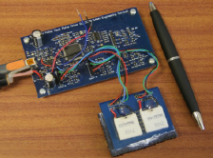
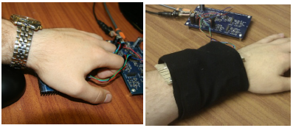
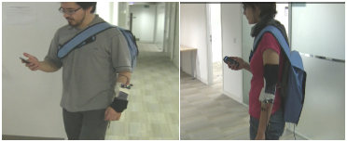
Microcontroller…
On the arm
… and Peltier
On the palm
users detect hot and cold stimuli presented to the fingertips, the palm and the arm
Two studies. One static indoor and one mobile
The experiment was repeated with the subjects walking around
“Some Like it Hot ? Thermal Feedback for Mobile Devices”
G. Wilson, M. Halvey, S. A. Brewster, and S. A. Hughes,
Notes:
Background: Thermal II
Static: Click the mouse when a change in thermal stimulation was felt. The temp of the peltier was recorded. Then rate the stimulus, “very hot” or “very cold” and “comfortable” and “very comfortable”.
Mobile: Wile walking.

Slide 10
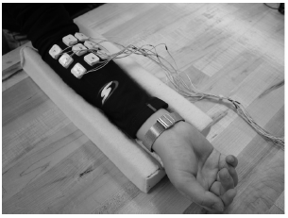
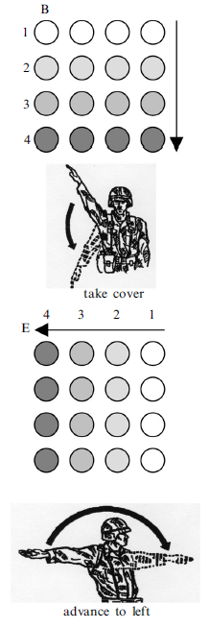
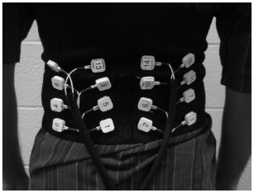
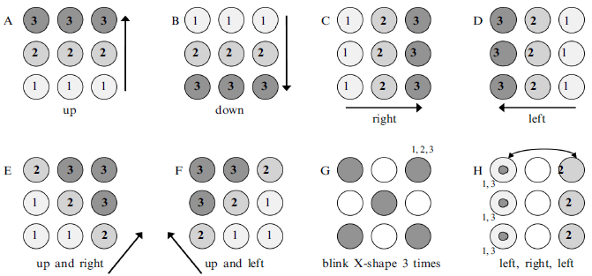
How a tactile display can communicate simple instructions and commands
On the arm
On the back
Simple patterns
Simple instructions
“Vibrotactile pattern recognition on the arm and back”
L. A. Jones, J. Kunkel, and E. Piateski
Notes:
Background: Vibration I
Participants would compare the vibration pattern with a cheat-sheet. Accuracy was different per pattern.
Compare patterns that signified hand and arm signals with the dots 98% and without 75%. Even when performing physical or cognitive tasks.

Slide 11
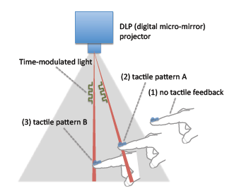
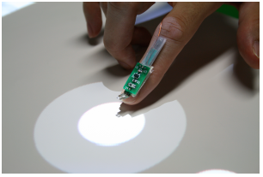
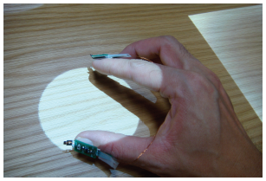
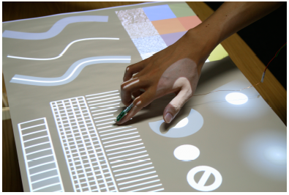
No need for positioning, the system detects structured light.
Full implementation of the system
Optical-haptic substitution
“SenseableRays: opto-haptic substitution for touch-enhanced interactive spaces”
J. Rekimoto
Notes:
Background: Vibration II
-Senseable Rays: Small and directly converts time-modulated light signals from a projector into haptic sensations.

Slide 12
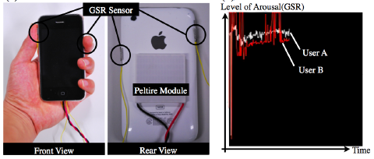
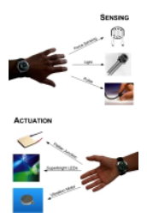
Background - INterface
pressages
Mobile communications

Slide 13
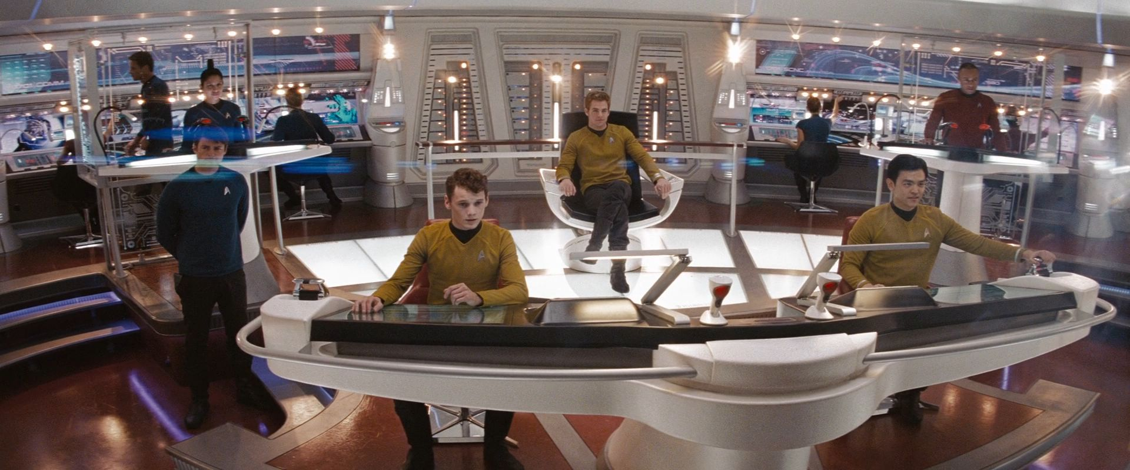
Situational awareness
Take information from the environment, integrate it with previous knowledge and form a coherent mental picture
Notes:
Background: Interfaces
Situational Awareness

Slide 14
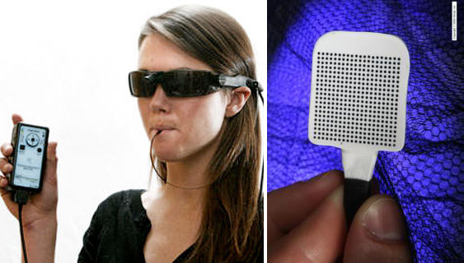
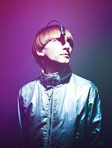
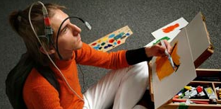
Images captured by the camera…
Sensory Substitution
… are translated to electrical signals in the tongue
“Brainport: an alternative input to the brain”
Y. Danilov and M. Tyler
Uses a color sensor and camera to translate…
… color information to sound
“Eyeborg”
Neil Harbisson
Notes:
Background: Sensory Substitution
-Barinport
-Eyeborg

Slide 15
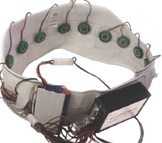
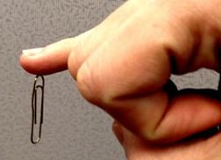
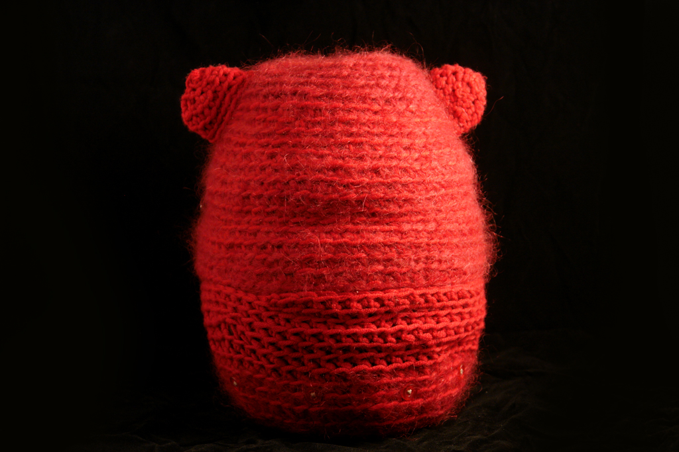
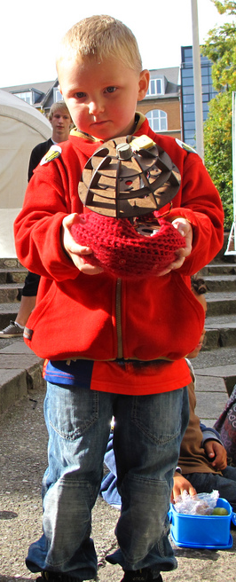
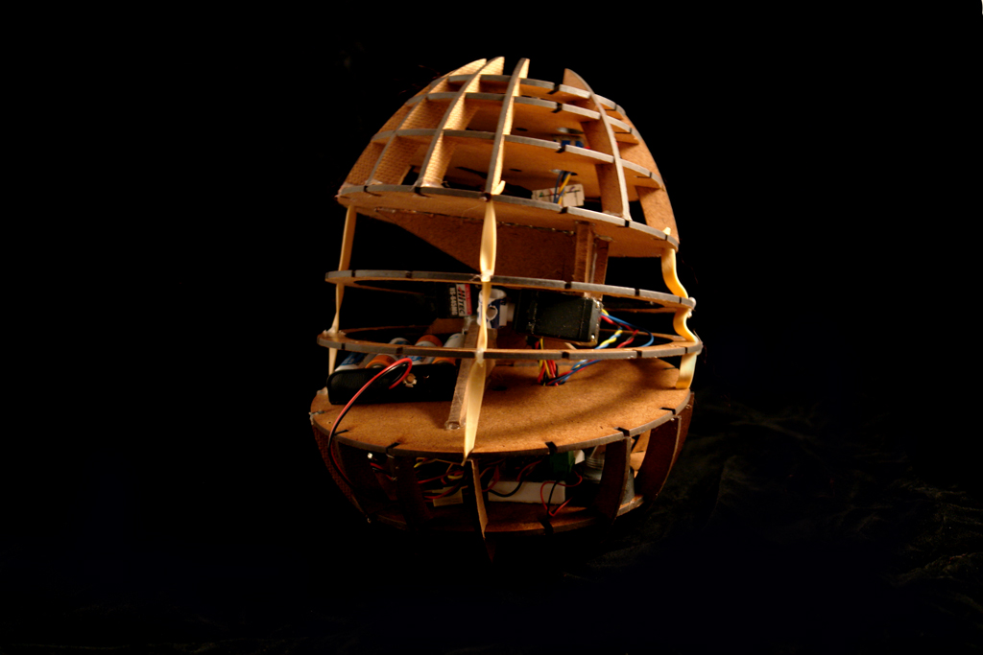
New Senses
“Body Hacking: My Magnetic Implant”
D. Berg
“feelSpace Belt”
Nagel, S. K., Carl, C., Kringe, T., Märtin, R., & König, P.
“MOMO: a haptic navigation device”
C. WANG and K. O’FRIEL
Notes:
Baground: new Senses
FeelSpace Belt
Implanted magnets
Momo

Slide 16
Background
Neuroplasticity

Slide 17
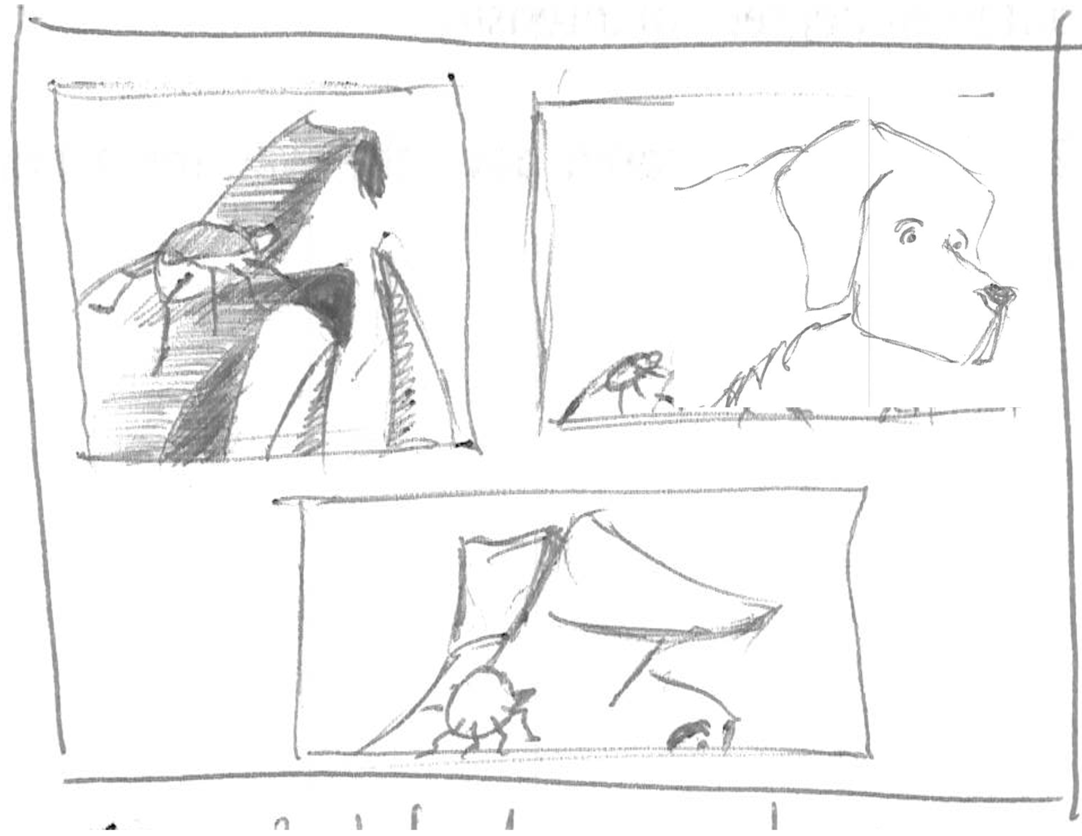
Digital Synesthesia
Uexkull

Slide 18
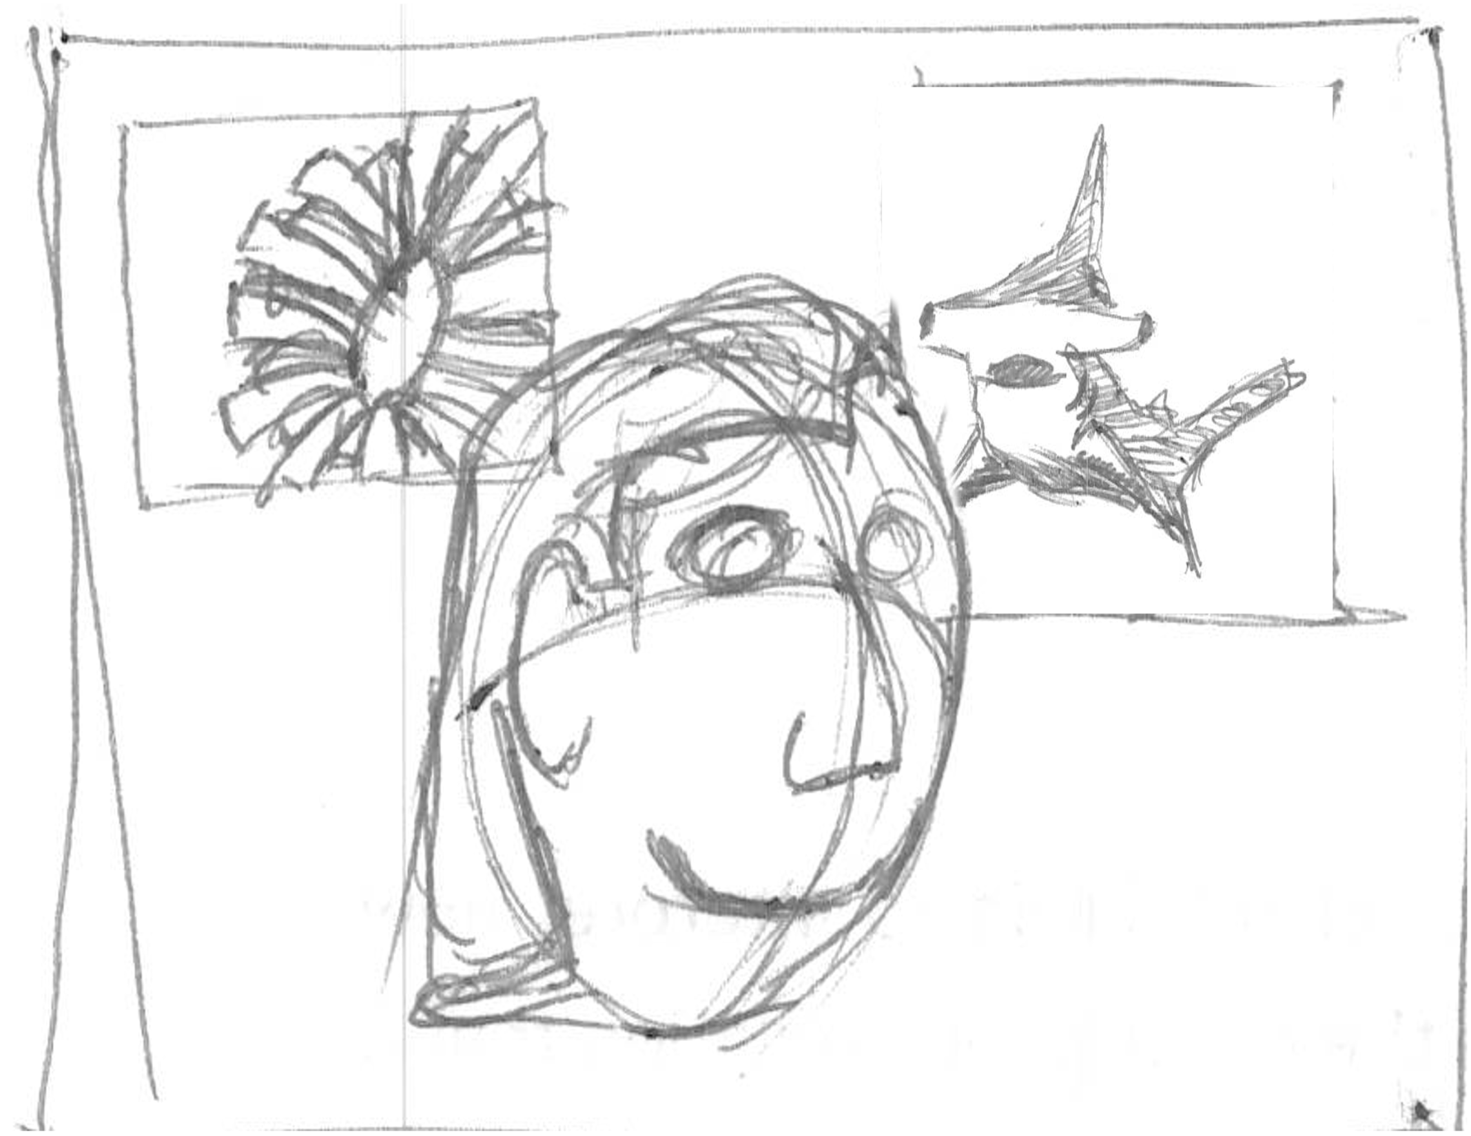
Digital Synesthesia
Nth sense

Slide 19
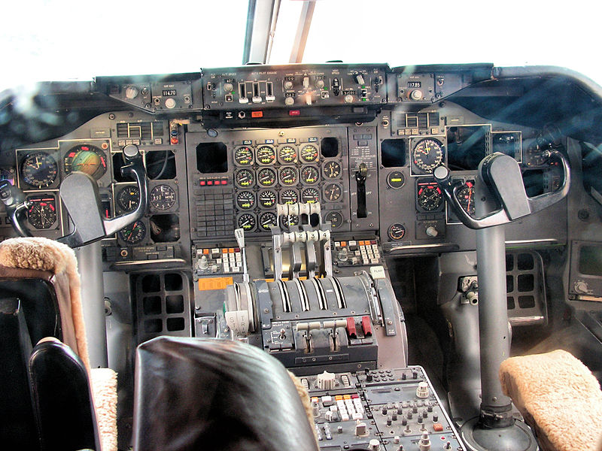
Digital Synesthesia
Cognitive Load

Slide 20
Digital Synesthesia
Personal interpretation

Slide 21
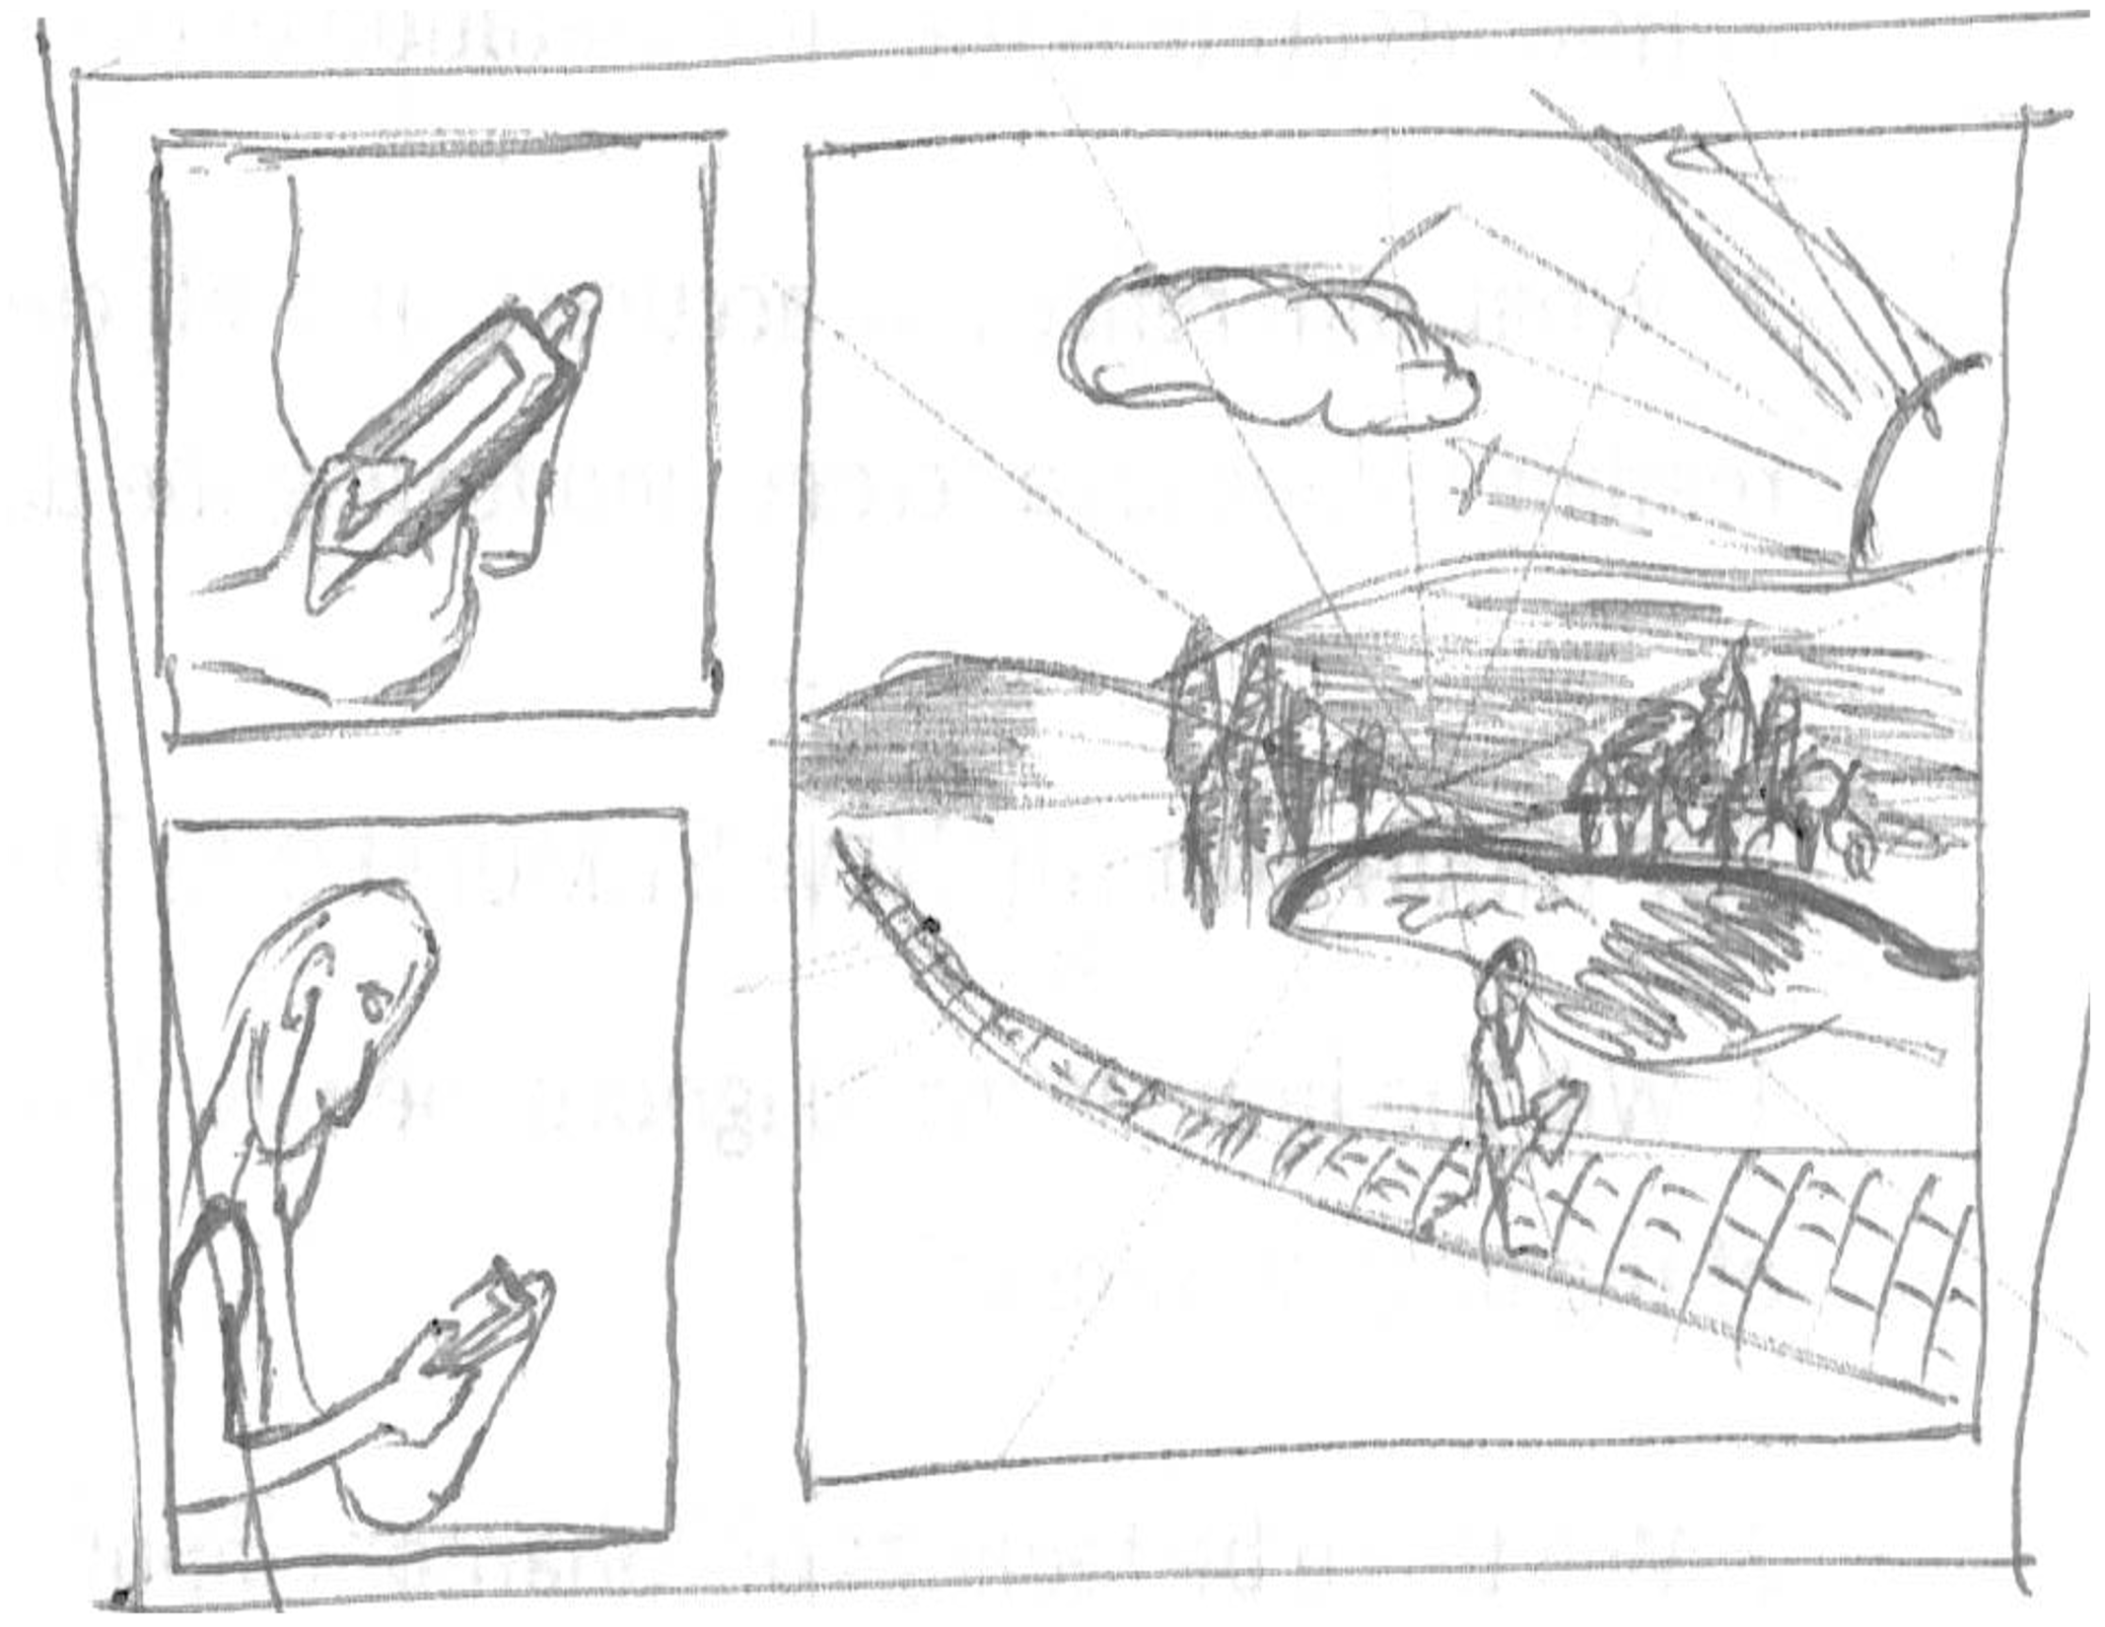
Digital Synesthesia
Immersion in the world

Slide 22
Research Questions
Discreet and Continuous Data

Slide 23
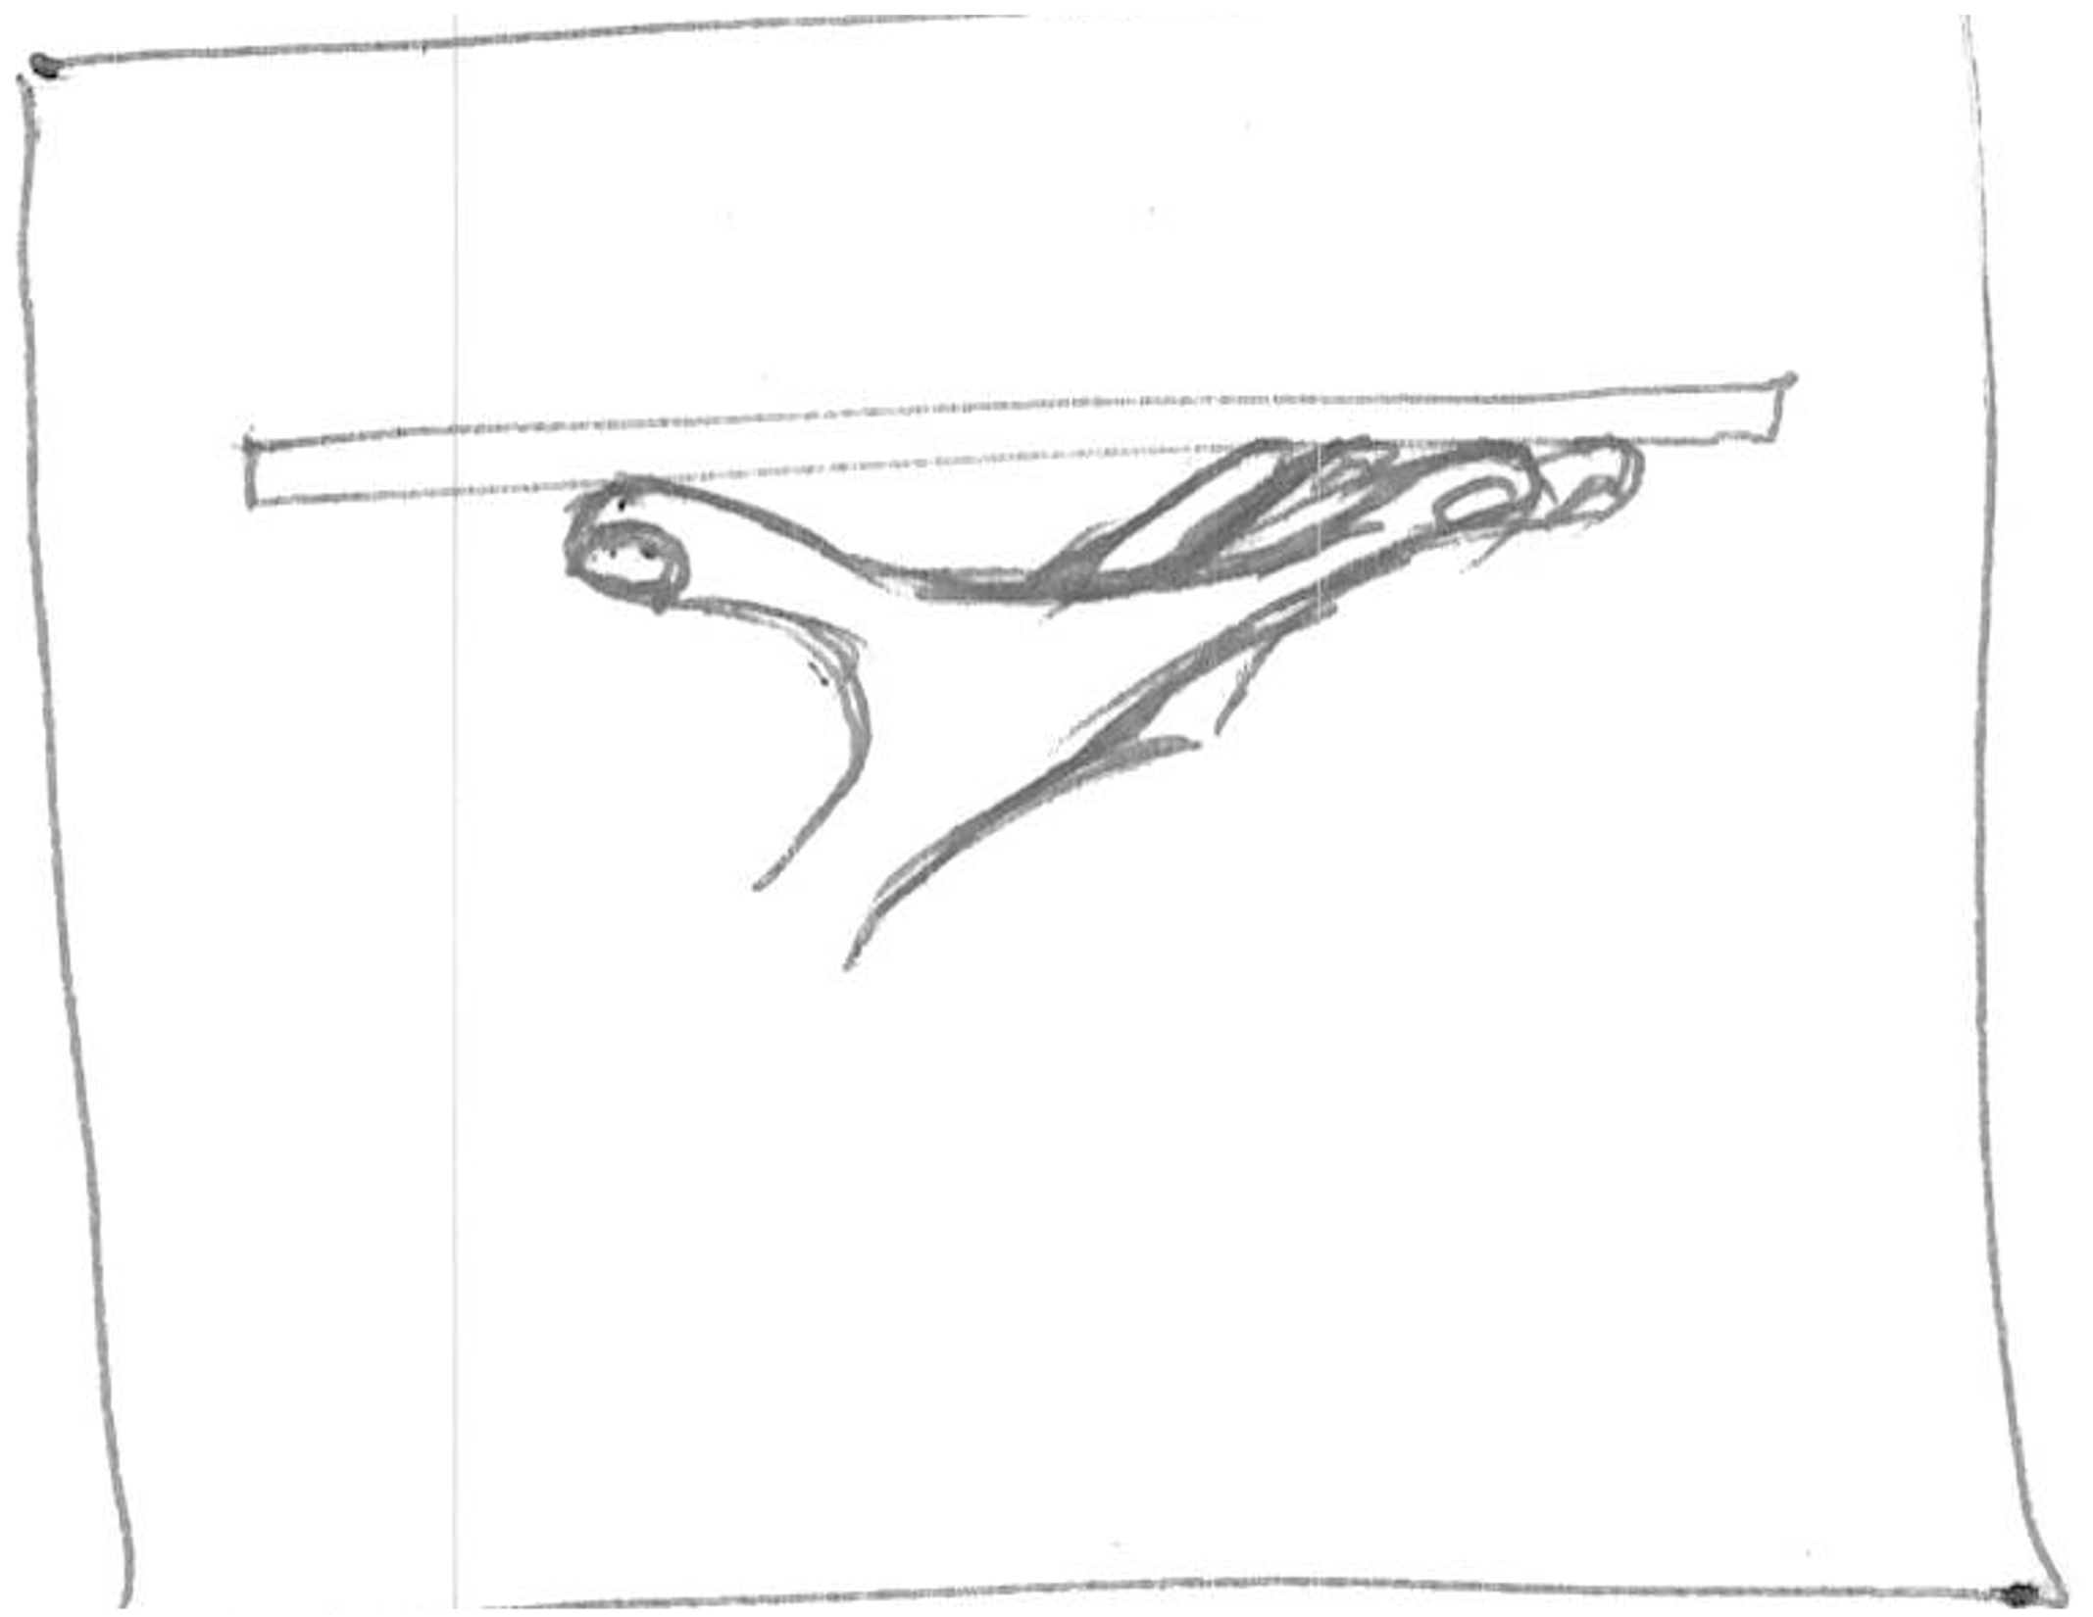
Research Questions
Sensory Augmentation

Slide 24
Research Questions
Sensory Substitution

Slide 25

Research PLan
Stage 1

Slide 26
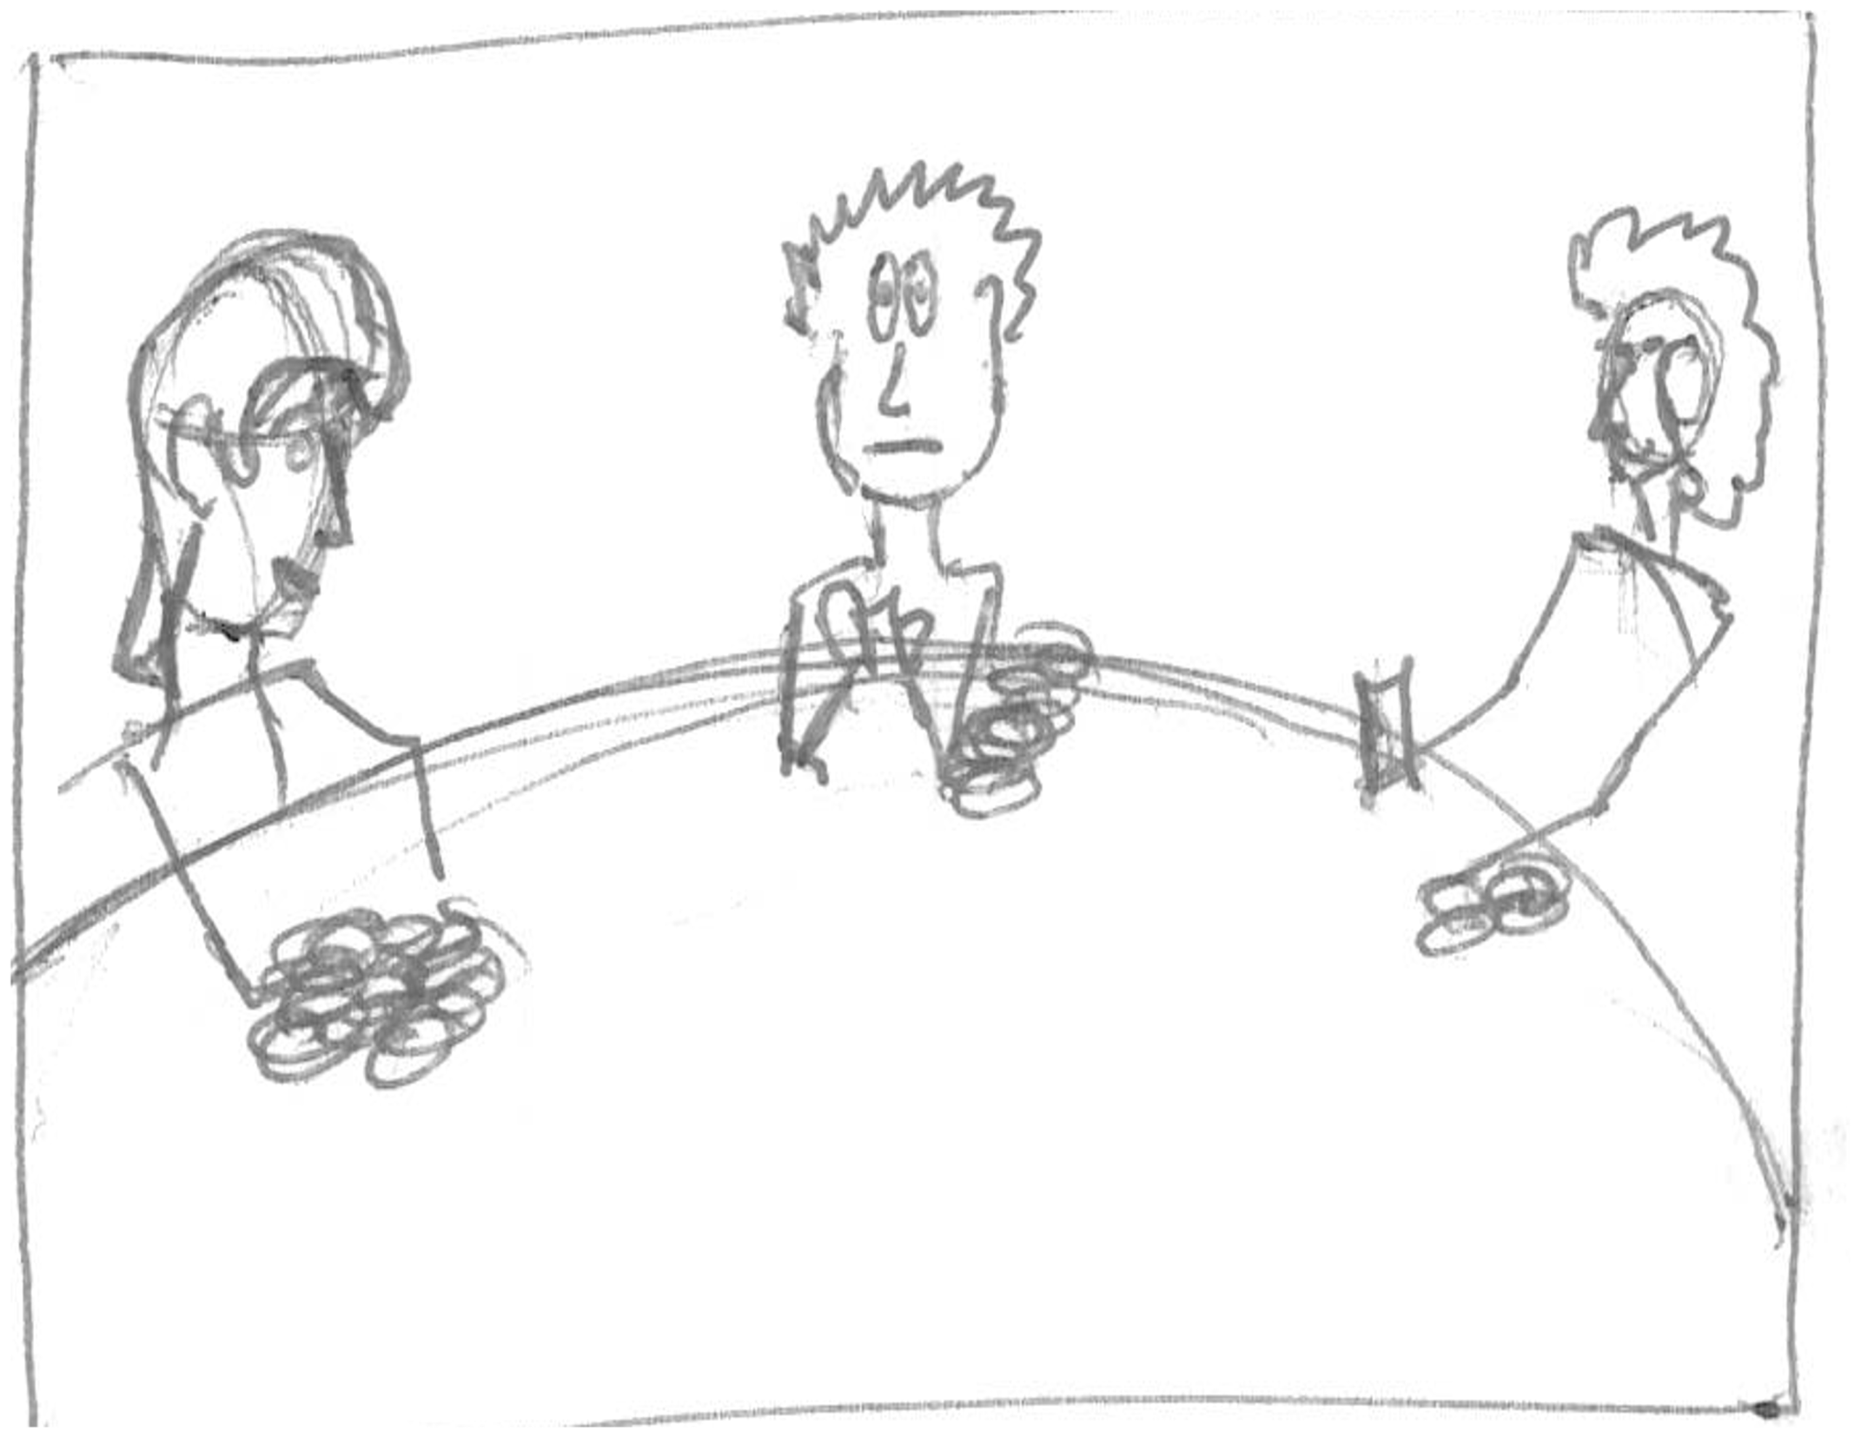
Research Questions
New Senses

Slide 27
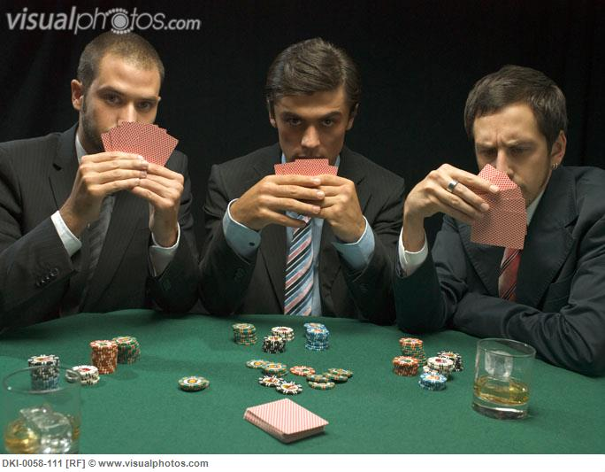
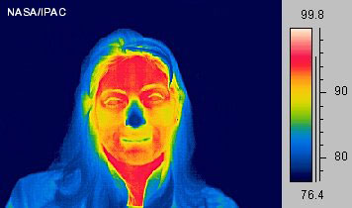
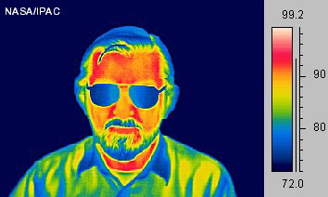
Research plan
Stage 2

Slide 28
Research Questions
New Stimuli

Slide 29
Research Questions
Escaping Visual

Slide 30
Research Questions
Human Development

Slide 31
Research Plan
Stage 3

Slide 32
Research Questions
Design thinking

Slide 33
Research Plan
Stage 4

Slide 34
Timeline

Slide 35
Conclusion

Slide 36
Thankyou
Questions.

